Slide 1
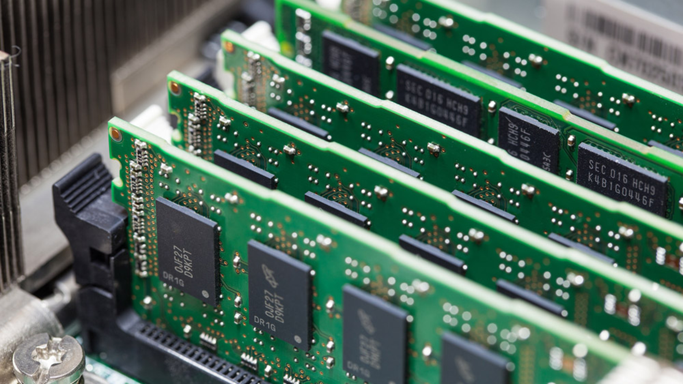
RAM (Random-access memory)

Slide 2
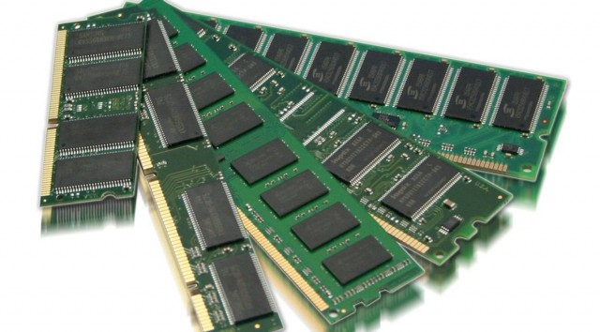
What Is Random Access Memory?
Random Access Memory, is the physical hardware inside a computer that temporarily stores data, serving as the computer's "working" memory. Random Access Memory is volatile. That means data is retained in RAM as long as the computer is on, but it is lost when the computer is turned off. When the computer is rebooted, the OS and other files are reloaded into RAM, usually from an HDD or SSD. RAM is found in servers, PCs, tablets, smartphones and other devices, such as printers.

Slide 3
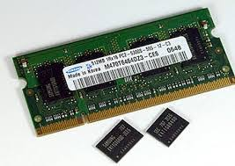
What Random Access Memory is used for?
Because of its volatility, Random Access Memory can't store permanent data. RAM can be compared to a person's short-term memory, and a hard drive to a person's long-term memory. Short-term memory is focused on immediate work, but it can only keep a limited number of facts in view at any one time. When a person's short-term memory fills up, it can be refreshed with facts stored in the brain's long-term memory.
A computer also works this way. If RAM fills up, the computer's processor must repeatedly go to the hard disk to overlay the old data in RAM with new data. This process slows the computer's operation.

Slide 4
How does RAM work?
The term random access as applied to RAM comes from the fact that any storage location, also known as any memory address, can be accessed directly. Originally, the term Random Access Memory was used to distinguish regular core memory from offline memory.
Offline memory typically referred to magnetic tape from which a specific piece of data could only be accessed by locating the address sequentially, starting at the beginning of the tape. RAM is organized and controlled in a way that enables data to be stored and retrieved directly to and from specific locations.
Other types of storage -- such as the hard drive and CD-ROM -- are also accessed directly or randomly, but the term random access isn't used to describe these other types of storage.
RAM is similar in concept to a set of boxes in which each box can hold a 0 or a 1. Each box has a unique address that is found by counting across the columns and down the rows. A set of RAM boxes is called an array, and each box is known as a cell.

Slide 5
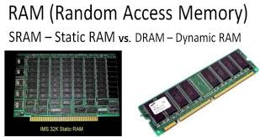
Types of Random Access Memory
RAM comes in two primary forms:
Dynamic Random Access Memory (DRAM)
Static Random Access Memory (SRAM)

Slide 6
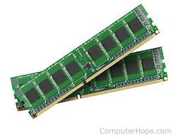
Dynamic Random Access Memory (DRAM) is a type of random access semiconductor memory that stores each bit of data in a separate tiny capacitor within an integrated circuit. The capacitor can either be charged or discharged; these two states are taken to represent the two values of a bit, conventionally called 0 and 1.
makes up the typical computing device's RAM and, as was previously noted, it
needs that power to be on to retain stored data.

Slide 7
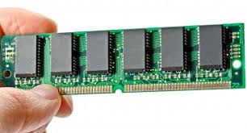
Static Random Access Memory (SRAM) is random access memory(RAM) that retains data bits in its memory as long as power is being supplied. Unlike dynamic RAM(DRAM), which stores bits in cells consisting of a capacitor and a transistor, SRAM does not have to be periodically refreshed.As a result, SRAM chips are much larger and more expensive than an equivalent amount of DRAM.
However, SRAM is significantly faster and uses less power than DRAM. The price and speed differences mean static RAM is mainly used in small amounts as cache memory inside a computer's processor.

Slide 8
RESOURCES:
https://searchstorage.techtarget.com/definition/RAM-random-access-memory
https://www.lifewire.com/what-is-random-access-memory-ram-2618159
https://en.wikipedia.org/wiki/Random-access_memory
https://www.webopedia.com/TERM/R/RAM.html
https://computer.howstuffworks.com/ram.htm

